Slide 1
Master Method
簡廷因 2020.10.22

Slide 2
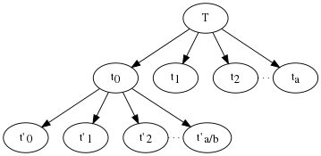
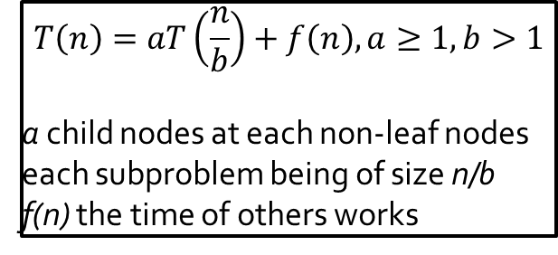
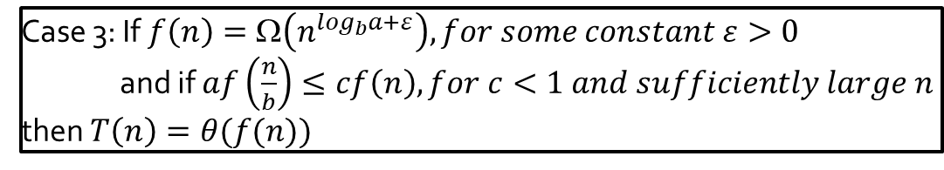
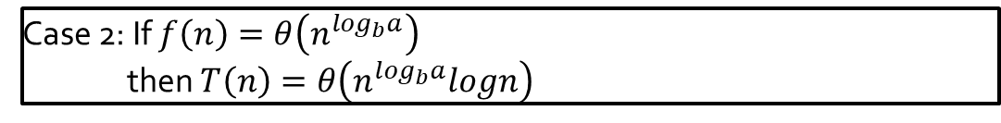
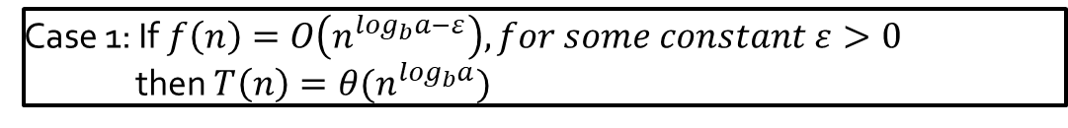
Master Method
$$T\left(n\right)=aT\left(\frac{n}{b}\right)+f\left(n\right), a≥1,b>1$$
a child nodes at each non-leaf nodes
each subproblem being of size n/b
f(n) the time of others works
Case 1: If $f\left(n\right)=O\left(n^{\log_{b}a−ε}\right), for some constant ε>0$
then $T\left(n\right)=θ(n^{\log_{b}a})$
Case 2: If $f\left(n\right)=θ\left(n^{\log_{b}a}\right)$
then $T\left(n\right)=θ\left(n^{\log_{b}a}logn\right)$
Case 3: If $f\left(n\right)=\text{Ω}\left(n^{\log_{b}a+ε}\right), for some constant ε>0$
and if $af\left(\frac{n}{b}\right)≤cf\left(n\right), for c<1 and sufficiently large n$
then $T\left(n\right)=θ(f(n))$

Slide 3
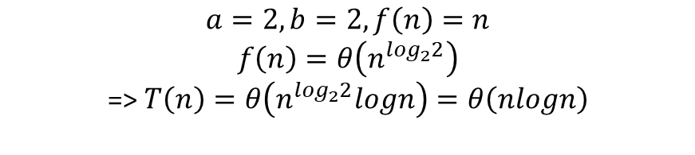

Example (merge sort) (case 2)
$$T\left(n\right)=2T\left(\frac{n}{2}\right)+n, T\left(1\right)=1⇒T\left(n\right)=θ(?)$$
$$a=2,b=2, f\left(n\right)=n$$
$$f\left(n\right)=θ\left(n^{\log_{2}2}\right)$$
=> $T\left(n\right)=θ\left(n^{\log_{2}2}logn\right)=θ\left(nlogn\right)$

Slide 4



Example (case 3)
$$T\left(n\right)=2T\left(\frac{n}{2}\right)+n^{3}, T\left(1\right)=1⇒T\left(n\right)=θ(?)$$
$$a=2,b=2, f\left(n\right)=n^{3}$$
$$f\left(n\right)=\text{Ω}\left(n^{\log_{2}2+ε}\right)$$
=> $T\left(n\right)=θ(f(n))=θ\left(n^{3}\right)$
$$af\left(\frac{n}{b}\right)≤cf\left(n\right), for c<1$$
$$2f\left(\frac{n}{2}\right)=2×{(\frac{n}{2})}^{3}=\frac{1}{4}n^{3}≤cf\left(n\right)=cn^{3}$$
$$c=\frac{1}{4}<1$$

Slide 5

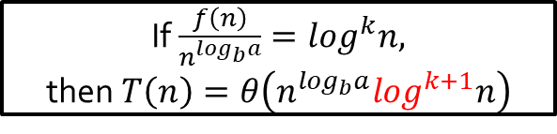
Extended Master Method
$$T\left(n\right)=aT\left(\frac{n}{b}\right)+f\left(n\right), a≥1,b>1$$
If $\frac{f\left(n\right)}{n^{\log_{b}a}}=\log^{k}n,$
then$T\left(n\right)=θ\left(n^{\log_{b}a}\log^{k+1}n\right)$

Slide 6
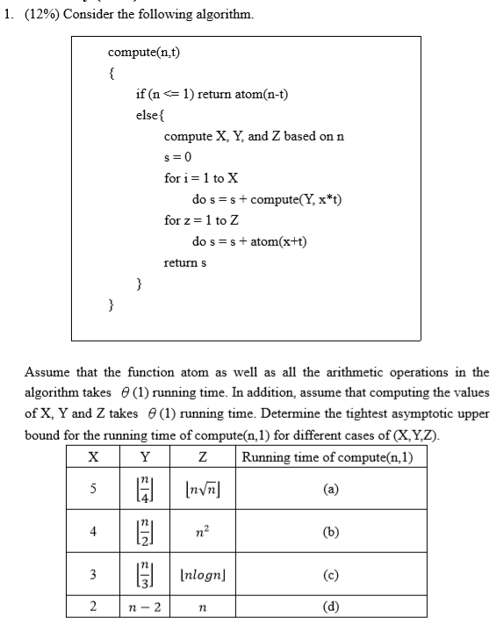



Example
$$T\left(n\right)=3T\left(\frac{n}{3}\right)+nlogn, T\left(1\right)=1⇒T\left(n\right)=θ(?)$$
$$a=3,b=3, f\left(n\right)=nlogn$$
$$\frac{f\left(n\right)}{n^{\log_{2}2}}=\log^{1}n, k=1$$
$$T\left(n\right)=θ\left(n\log^{2}n\right)$$

Slide 7
Q&A

